Slide 1
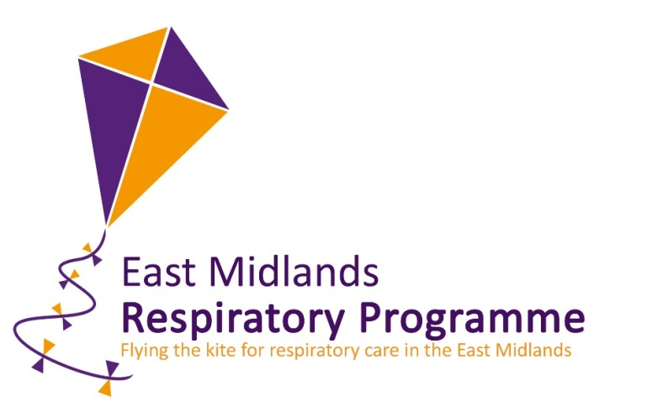

Improving Oxygen Prescription and Titration using novel silicone wristbands
Dr Sarah Forster
Academic Clinical Fellow in Respiratory Medicine
National COPD Audit Programme 27th July 2016

Slide 2

Oxygen is the most commonly used drug in Emergency Medicine
34% of emergency ambulance patients receive oxygen
  Oxygen used in 2 million ambulance journeys/year
14% of UK hospital patients receive oxygen at any given time
  18 000 people/day
  2 million people/year

Slide 3
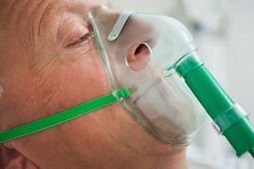
Oxygen can save lives...
Essential in severely ill patients with low blood oxygen levels

Slide 4
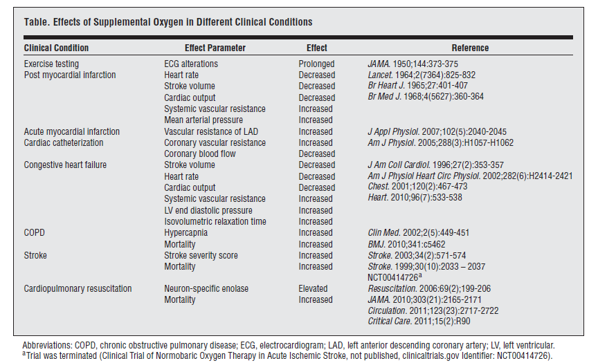
...but too much can be harmful

Slide 5
Acute Exacerbations COPD
RCT titrated oxygen verses high concentration oxygen in pre-hospital setting
Mortality reduced by 58% overall (78% in those with confirmed COPD)
9% to 2% in those with confirmed COPD
Number needed to harm = 15
Estimated 2000-4000 avoidable deaths per year in UK

Slide 6
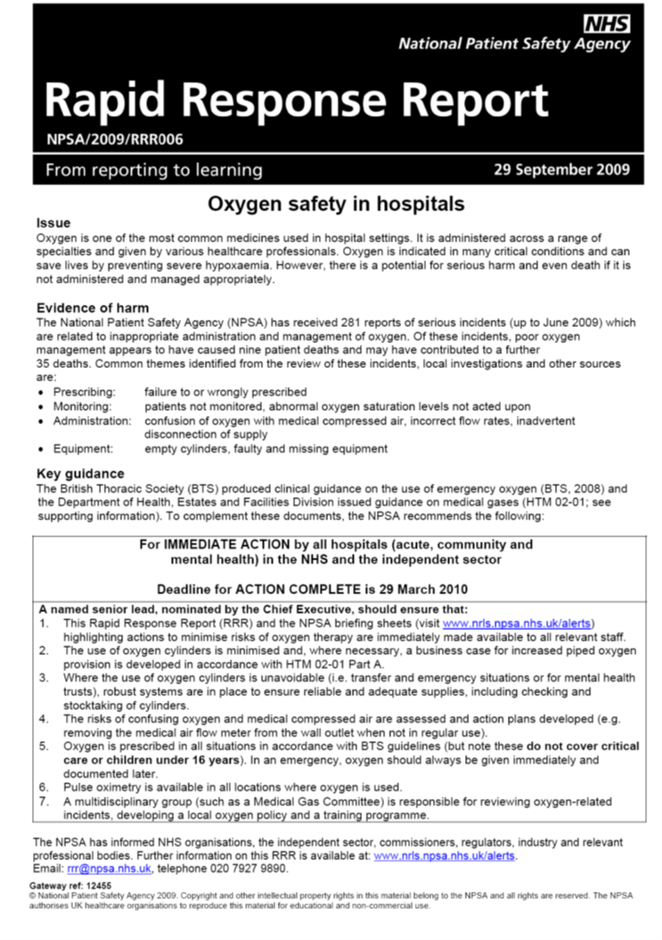
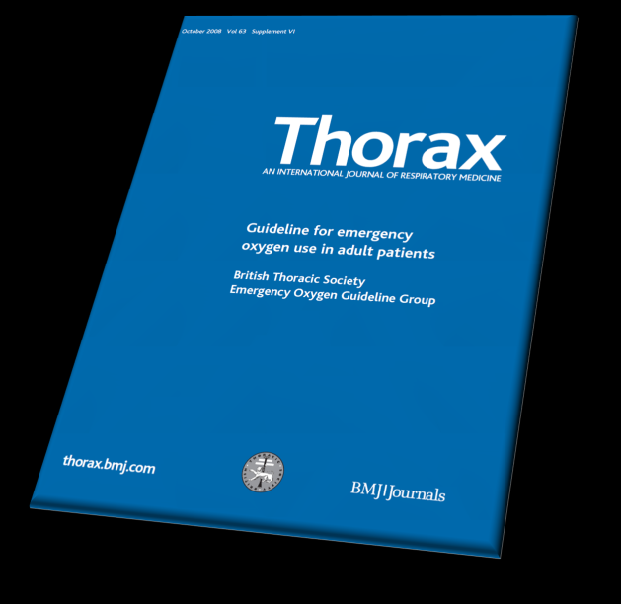
Guideline developed 2008 and NPSA recommendation 2009

Slide 7

British Thoracic Society - Acute Exacerbation of COPD care bundle trialled over 13 months: November 2012- December 2013
Receipt of oxygen prescription component at admission demonstrated a significant reduction in mortality- OR 0.22 (95%CI 0.05-0.88)
Oxygen prescription at admission also associated with reduced length of stay- with increased likelihood of a length of stay of less than 5 days
British Thoracic Society Pilot Care Bundle Project: A Care Bundles-Based Approach to Improving Standards of Care in Chronic Obstructive Pulmonary Disease and Community Acquired Pneumonia
Calvert, J et. al 2014

Slide 8
The problem persists….
KEY FINDING: 42.5% of patients receiving supplemental oxygen had no valid prescription, despite 70% of hospitals having a policy of setting a target saturation range for all patients at the time of admission to hospital.
British Thoracic Society Emergency Oxygen Audit Report
National Audit Period: 15 August – 1 November 2015
Ronan O’Driscoll

Slide 9

Only 69% of patients with a prescribed target range had a saturation within the intended range.
  9.5% of patients were below the target range
  21.5% were above the target range.
8.8% of patents using oxygen were found to be at risk of iatrogenic hypercapnia due to being above their target range by more than 2% despite recognised risk of hypercapnia (prescribed target range of 88-92% or less)
British Thoracic Society Emergency Oxygen Audit Report
National Audit Period: 15 August – 1 November 2015
Ronan O’Driscoll

Slide 10
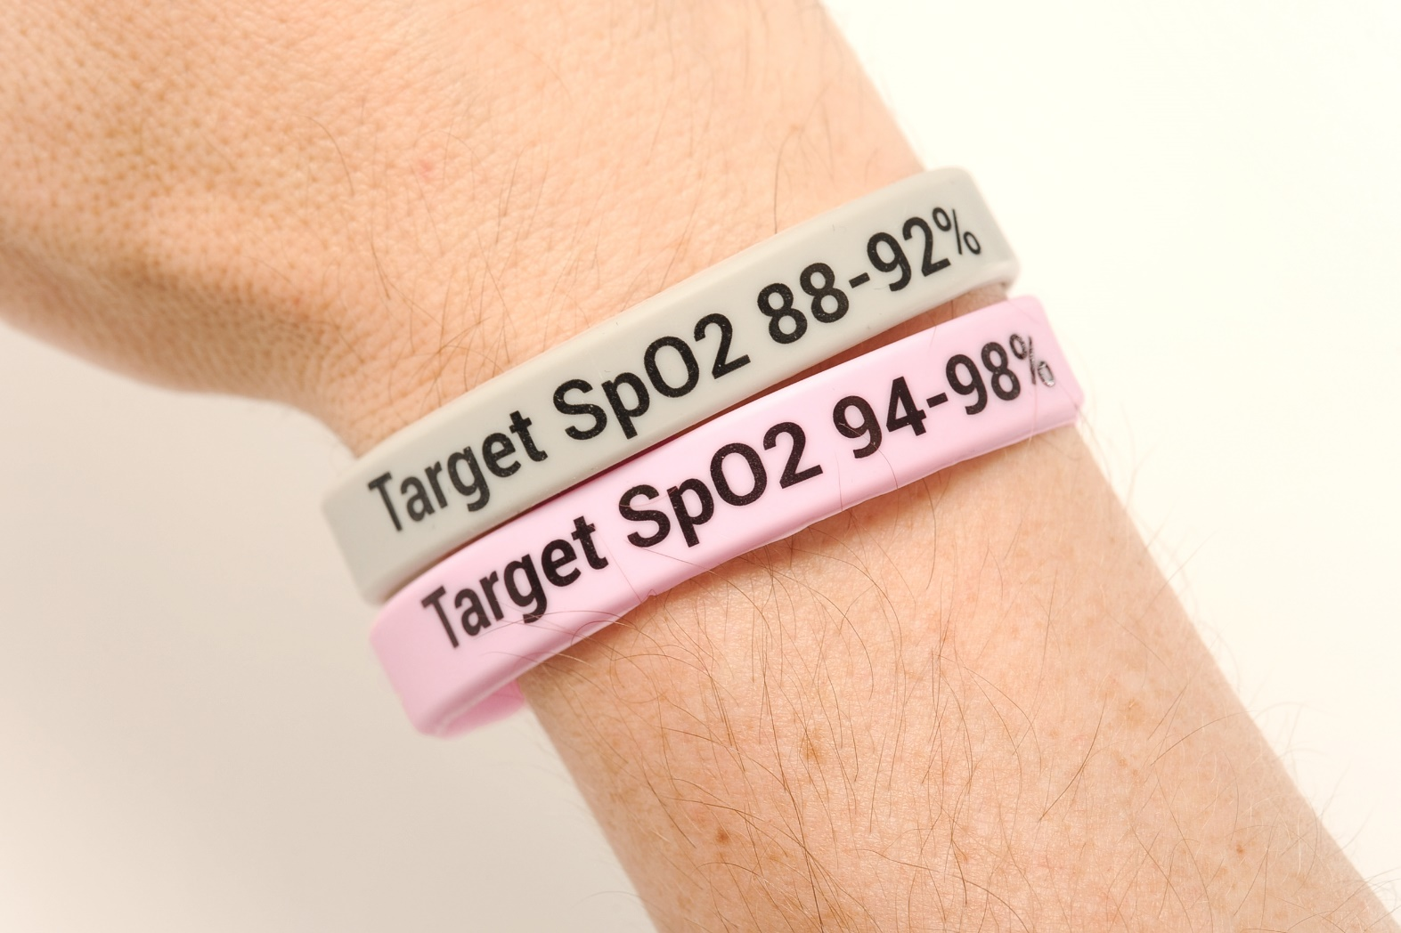
Improving Oxygen prescription and titration using novel silicone wristbands

Slide 11
Project Outline
Initial proof of concept at Royal Derby Hospital 2013/4
3 Acute Trusts in the East Midlands
  Nottingham City Hospital
  Glenfield Hospital, Leicester
  Kings Mill Hospital, Mansfield
3 month project April 2015-July 2015
Over 2000 emergency medical admission across the 3 units

Slide 12

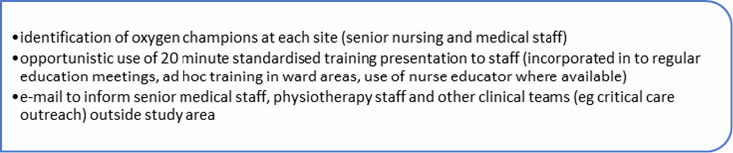

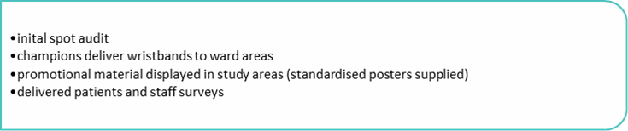
Timeline of project

Slide 13
Process of wristband allocation

Slide 14

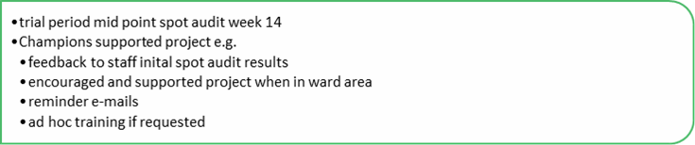

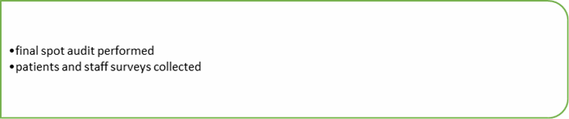
Timeline of project

Slide 15
Outcome Measures
Number of patients receiving oxygen - denominator Number of patients with oxygen prescription - numerator Number of patients within the target saturations - numerator Percentage of Arterial blood gas sampling where pO2 >13 kPa Mortality and length of stay for COPD (HES data) Additional subjective elements: Patient survey assessing understanding, improvement in knowledge, comfort and reassurance. Staff survey assessing the response of each member of the ward team as to whether they felt the intervention helped to manage patient oxygen usage

Slide 16
Results
2/3 sites showed improvement in oxygen prescription rates
  Glenfield 64% to 98%
  Kings Mill 76% to 94%
  Nottingham City 74% to 69%

Slide 17
Results
2/3 sites showed improvement in titration
  Glenfield 61% to 98%
  Kings Mill 52% to 94%
  Nottingham City 41% to 33%

Slide 18
Results
No statistically significant reduction in pO2>13 on ABGs (data from 2 sites only)
No significant change in length of stay or mortality over 16 week period 1077 AECOPD coded admissions
  Not confined to project area

Slide 19
Staff survey results by staff role n=92

Slide 20
Patient Survey Results n=192

Slide 21
Conclusions
Colour-coded Oxygen wristbands can improve safe prescription and titration of oxygen
Popular with staff and patients
No clear benefit in terms of improve outcomes in this project
  ?too small ?too short
Successful implementation is site specific
  Consider local factors!

Slide 22

Project Team
Dr Gillian Lowrey
Dr Charlotte Bolton
Jane Scullion
Dr Amy Binnion
Dr David Hodgson
Dr Kimuli Ryanna
Dr Rachel Evans
Sue Smith
Dr Sarah Forster
Dr Priya Daniels
Lucy Briggs
Dr Omar Bajammal
Dr Gauri Saini

Slide 23

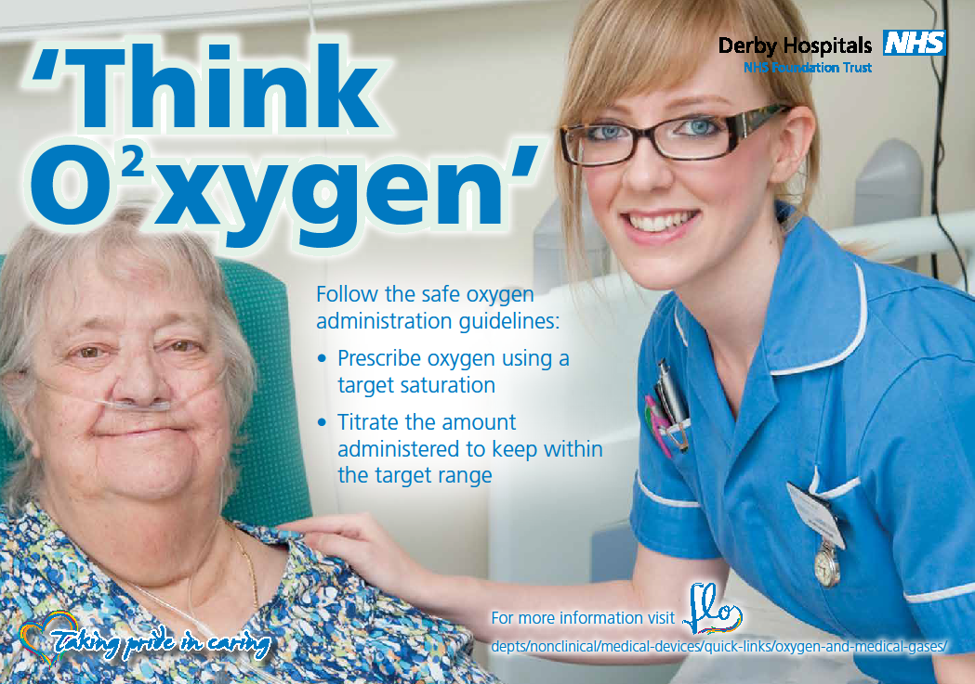
Any Questions?

