Slide 1
Outcomes from the Secondary Care COPD Audit 2014
Findings and quality improvement

Slide 2
The audit programme partnership
Working in strategic partnership:
Supported by:
Commissioned by:

Slide 3
Outcome report
Reported outcomes for patients whose index admission with COPD exacerbation occurred during the 2014 secondary care audit in England.
The outcomes examined:
Mortality
Readmissions
Length of stay
In admission, preadmissions were also looked at.
Outcomes were sourced by linking audit data to data held by the Hospital Episode Statistics (HES) and the Office for National Statistics (ONS).

Slide 4
Included in the outcome report
183 hospitals
12,594 patients

Slide 5
Inpatient mortality
Associated with inpatient mortality
↑ age
↑ co-morbidities
Chest x-ray consolidation
↑ MRC score
↑ GOLD stage
↑ DECAF score
Initial acidotic pH
ITU assessment need
Treatment with NIV

Slide 6
Mortality within 30/90 days of index admission
Within 90 days:
COPD was the main cause of death.
30 days: 71%
90 days: 67%

Slide 7
Mortality within 30/90 days of index admission
Higher mortality within 30/90 days associated with*:
NIV
Longer length of stay
Increasing age
Dementia / confusion
Cardiovascular disease
Kidney disease
Chest x-ray consolidation
Higher DECAF score
* All P < 0.05

Slide 8
Length of stay (LOS)
There has been a reduction in LOS (6 days 2003, 5 days 2008, 4 days 2014).
Associated with increasing LOS*
Age
Number of comorbidities
Chest x-ray consolidation
Higher MRC and DECAF score
Higher GOLD stage
Receipt of NIV
Lower pH
* P < 0.001

Slide 9
Readmission 30/90 days after index discharge
Patients who were readmitted for any reason within 30 days (24%), and within 90 days (43%).
12% were readmitted at least once within 30 days owing to COPD.
23% were readmitted at least once within 90 days owing to COPD.

Slide 10
Readmission 30/90 days after index discharge
Readmission rates increase with:*
Deprivation
Age
Number of co morbidities
Longer LOS
Disease severity markers
Higher MRC score
Higher GOLD stage
Low initial pH
NIV management on HDU during admission
* P < 0.01

Slide 11
Previous/recent admissions prior to the index admission
65% of patients had ≥ 1 admission in the prior 365 days
36% of patients had ≥ 1 admission in the prior 90 days
51% of patients had ≥ 1 admission in the prior 180 days

Slide 12
Use QI methodology to plan/enact your methodology
Work as a team
Decide what you want to improve
Use a driver diagram to identify the drivers for change
Plan your change using a PDSA template
Have clear lines of responsibility
Meet regularly to performance manage yourselves

Slide 13
SMART
Aim development should focus on SMART objectives.
Look for areas where you can realistically make improvements.
Build a team and understand your stakeholders.
Plan how you will achieve your aim.
What measures will you use to show you are improving?
S
Specific
M
Measurable
A
Achievable
R
Realistic
T
Time bound

Slide 14
Driver diagrams
To decide what to start on for your overall improvement aim, you may find it helpful to use a driver diagram.
The Institute for Healthcare Improvement has a helpful guide on how to use them http://www.ihi.org/resources/Pages/Tools/Driver-Diagram.aspx
AIM PRIMARY DRIVERS SECONDARY DRIVERS

Slide 15
Driver diagrams – COPD example
AIMS PRIMARY DRIVERS SECONDARY DRIVERS
To ensure safe and appropriate administration of oxygen to those admitted with AECOPD
Develop policy that all inpatients have a target saturation prescribed on admission
Incorporate prescription into electronic or paper prescription charts
Maximise oxygen prescription using target saturations
Use visible cue to target oxygen saturations at bedside eg oxygen target saturation wristbands
Flow chart to aid healthcare staff with titration
Ensure safe titration of oxygen
Ensure oxygen safety training is accessible to all
Incorporate oxygen safety into induction for medical, pharmacy, nursing and healthcare assistants
Ensure all staff are trained in oxygen administration
Establish oxygen safety group incorporating patient safety, respiratory physician, anaesthetics, pharmacy, nursing, education and communication departments
Use national audit to feedback performance
Reduce harm events resulting from oxygen

Slide 16
Model for improvement and PDSA cycles
To plan your change, it is important to regularly measure and study your activity using:
Act
Plan
Do
Study
Model for improvement
What are we trying to accomplish?
How will we know that a change is an improvement?
What changes can we make that will result in improvement?
If the first cycle of improvement does not achieve the requisite change, you may need to try again with a second innovation.

Slide 17
Quality Improvement
Example: Patients are not receiving NIV in a timely way.
Plan: Investigate the number of patients admitted who currently receive NIV and the time at which they receive it (BTS guidelines recommend patients receive NIV within one hour).
Do: Make changes based on your findings:
*Add a question to admission proforma asking if NIV was considered
Act: Identify gaps in your improvement & speak to those who can help
Study: Plot the change over time

Slide 18
Quality Improvement
Example: Low usage of discharge bundle potentially increasing readmission rates.
Plan: Investigate the number of patients admitted who currently receive the discharge bundle (you can use the run-charts in the continuous audit)
Do: Implement the use of a discharge bundle notification system at admission
Act: Identify gaps in your improvement and speak to those who can help
Study: Has the rate improved?

Slide 19
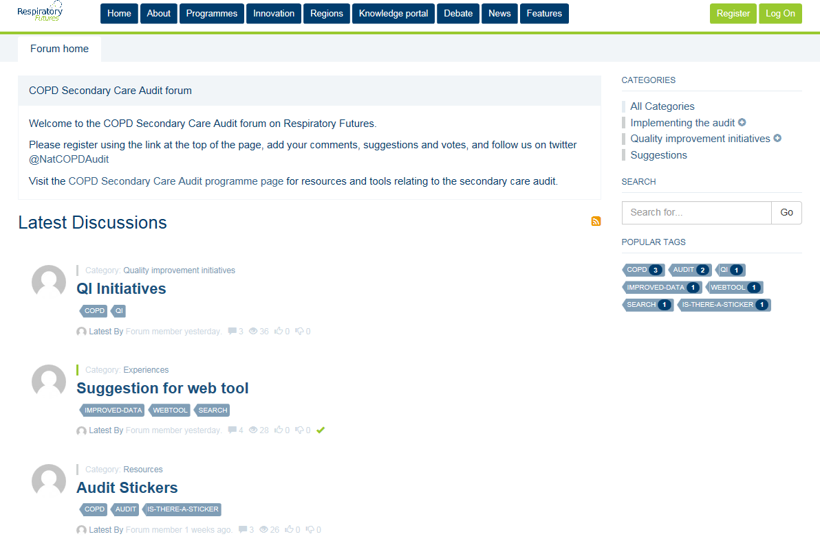
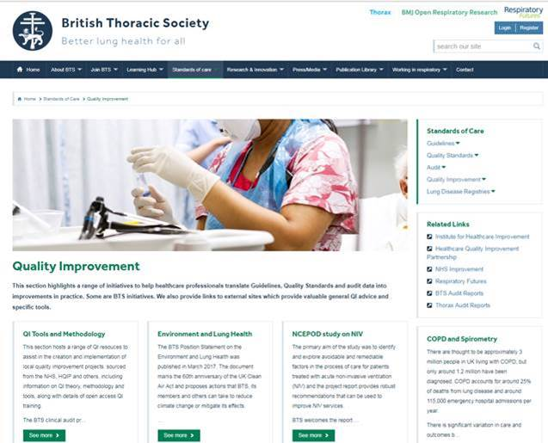
Useful QI resources
Respiratory Futures Forum - http://www.respiratoryfutures.org.uk/copdsecondarycareauditforum/
Login and share learning and suggestions about the audit.
The British Thoracic Society QI site has a range of resources available - https://www.brit-thoracic.org.uk/standards-of-care/quality-improvement/

Slide 20
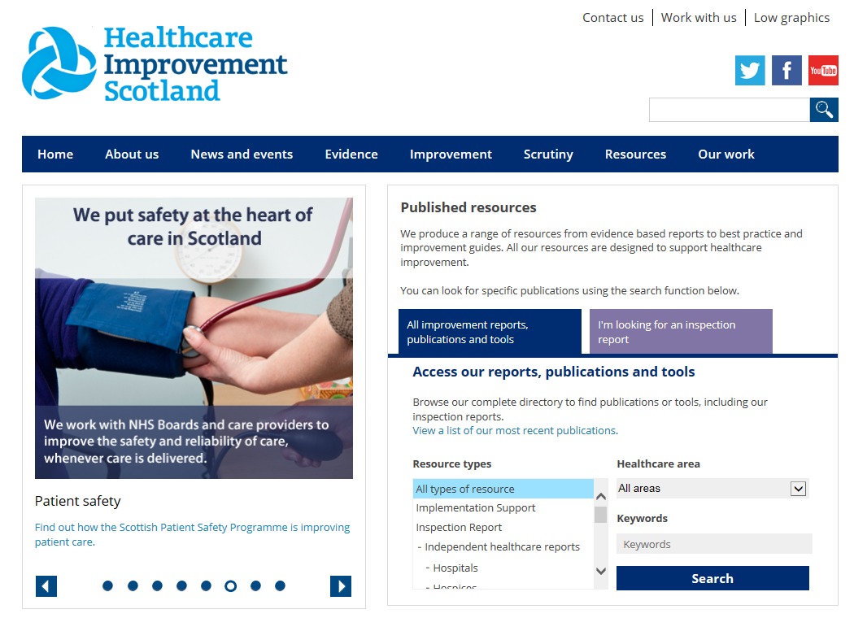
Useful QI resources
The Institute for Healthcare Improvement (IHI)
http://www.ihi.org has a host of resources.
Healthcare Improvement Scotland also has a range of resources http://www.healthcareimprovementscotland.org/

Slide 21
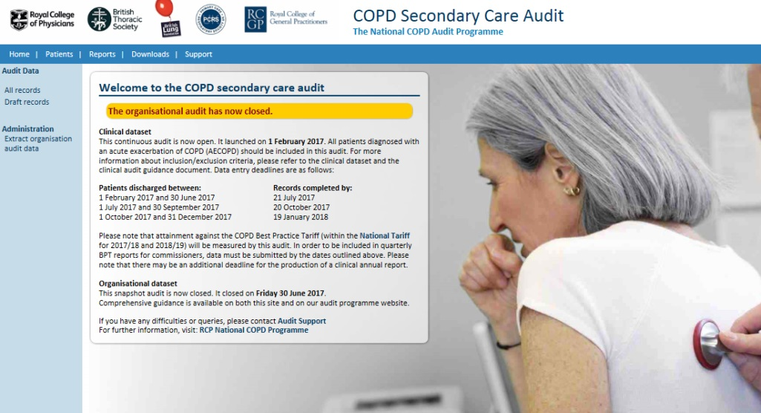
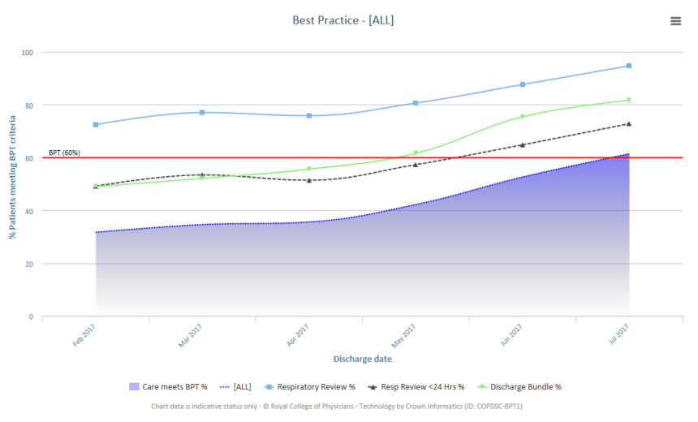
What happens next?
Use the audit web-tool to collect your data to support your local QI initiatives: www.copdaudit.org
Use the online reporting and run charts so you can track your progress.
View the good practice repository available on our website: https://www.rcplondon.ac.uk/projects/outputs/secondary-care-workstream-audit-resources

Slide 22
National COPD Audit Programme

